Slide 1
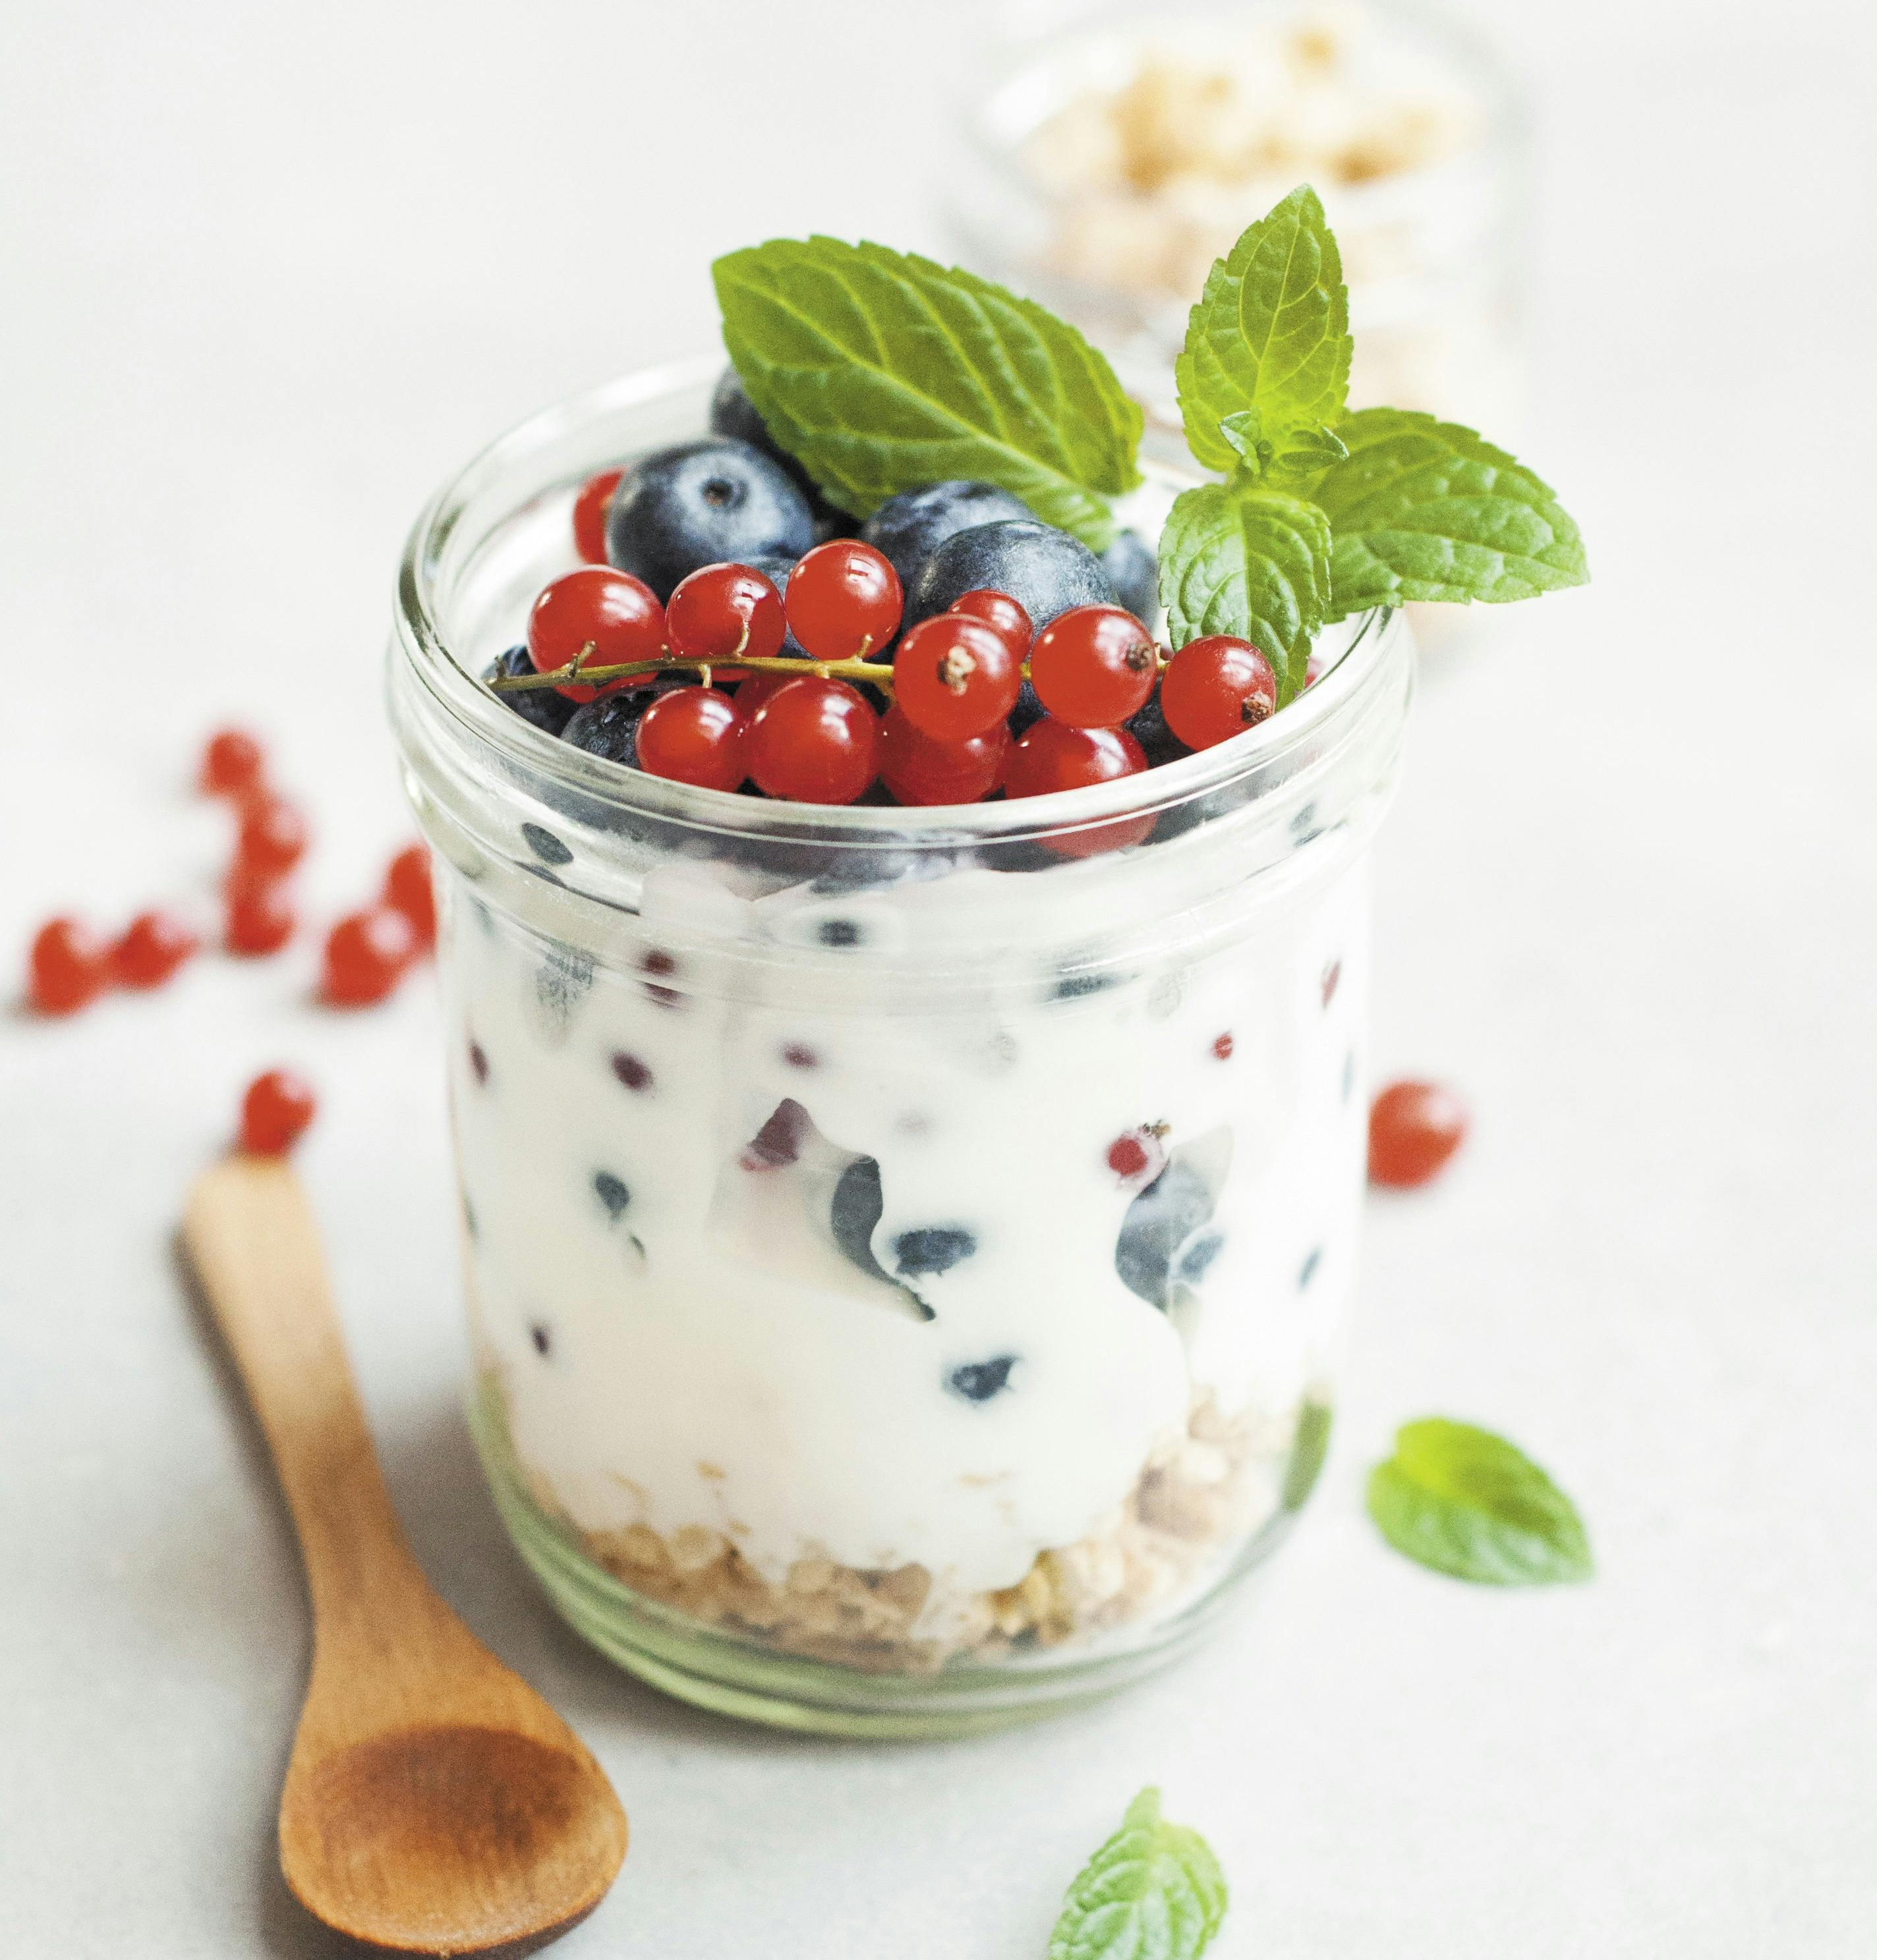
Wellness Workshop: Nutrition & Meal Prep for the Whole Family
August 28, 2024

Slide 2
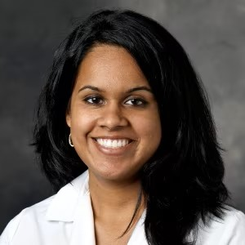
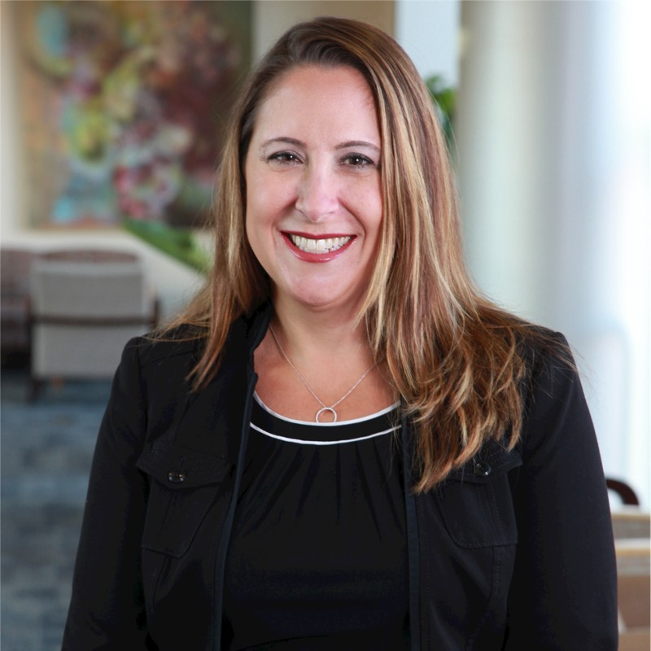
Today’s Speakers
Dr. Sheila Kumar
National Institute of Diabetes and Digestive and Kidney Diseases
Amber Courville
National Institute of Diabetes and Digestive and Kidney Diseases
Leslie Pont
NIH Office of Research Services
Program & Employee Services
DATS Amenities Branch
Dr. Kumar trained at Johns Hopkins University for her undergraduate degree and received her MD from Yale University. She then completed her internal medicine residency at Columbia University, followed by Stanford University for her gastroenterology fellowship, where she also obtained her MS. Her interests are in colorectal cancer, health disparities, and training the next generation of gastroenterologists. She is the Principal Investigator for an NIDDK protocol- “Evaluation of Patients with Gastrointestinal Disease.” Dr. Kumar is also involved in several collaborative projects with investigators within NIDDK, as well as other institutes within the NIH.
Amber Courville, PhD, RDN is currently a Staff Scientist with the Energy Metabolism Section and Human Energy and Body Weight Regulation Core at NIDDK. She has over 15 years’ experience planning highly controlled metabolic diets for research protocols at both the United States Department of Agriculture Beltsville Human Nutrition Research Center and at the NIH Clinical Center. Dr. Courville’s main research interests are the regulation of food intake, energy and macronutrient metabolism and body composition. Her current research focuses on the effect of dietary interventions on human energy metabolism and obesity.
Leslie Edsall, MA, CHES is currently the Program Manager for NIH Wellness programs. She has over two decades of experience in Healthcare Communication, Coaching & Fitness, Health Education, Mindfulness and Well-being. Leslie holds a Master’s in Organizational Leadership from Gonzaga University and several certifications. She is passionate about employee well-being and improving organizational culture. Her current projects include applying a holistic approach to wellness at NIH, fostering resilience through well-being, and building a community of belonging for the NIH community.

Slide 3
Agenda
1 | Understanding the Microbiome
2 | How to Build a Healthy Plate
3 | Meal Prep Tips and Tricks
4 | Resources

Slide 4
Let’s Share!
By the end of our workshop: Add your favorite recipes (website or app) or meal planning ideas into the anonymous Google Doc shown in the chat feature
Notes:
Intro Google link, share recipe by the end of the workshop: https://docs.google.com/spreadsheets/d/1EnKLGz5WNlyLYE3KynN-fifV91a2B1kMAV7VaIrBEiw/edit?usp=sharing

Slide 5
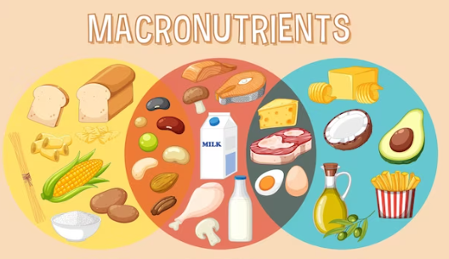
Why Nutrition is Important
Basics of Nutrition
Carbohydrates: Fuel your body with immediate energy.
Protein: Provides essential amino acids for building muscle, skin, blood, and brain structures.
Fat: Contains essential fatty acids and is used for specific functions.
Calorie Content of Macronutrients
Carbs: 4 calories per gram / 45-65% of daily calories
Protein: 4 calories per gram / 10-35% of daily calories
Fat: 9 calories per gram / 20-35% of daily calories
USDA.gov Guidelines
Adults and children, USDA recommends at least 130 grams of carbs/day
Recommended daily allowance (RDA) / considered the necessary amount to provide your brain with enough glucose to function.

Slide 6
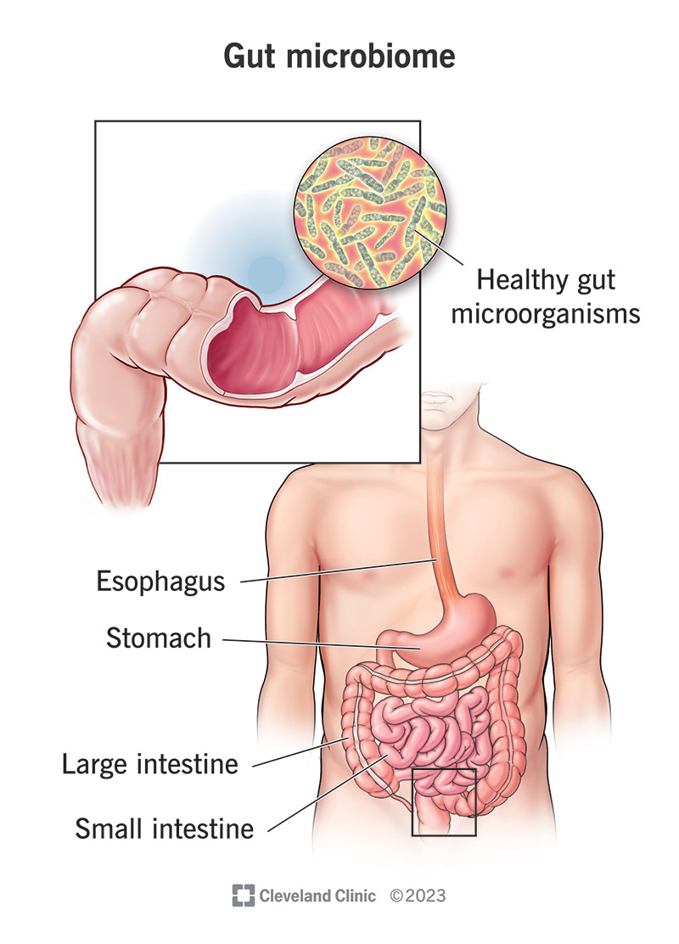
Defining the Microbiome
What is the Microbiome?
Notes:
Sheila’s slides

Slide 7
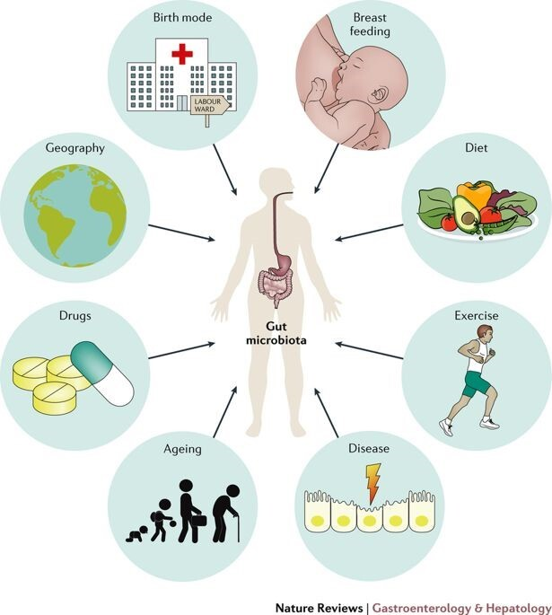
What Affects the Gut Microbiome?
Diet
Antibiotics
Infection

Slide 8
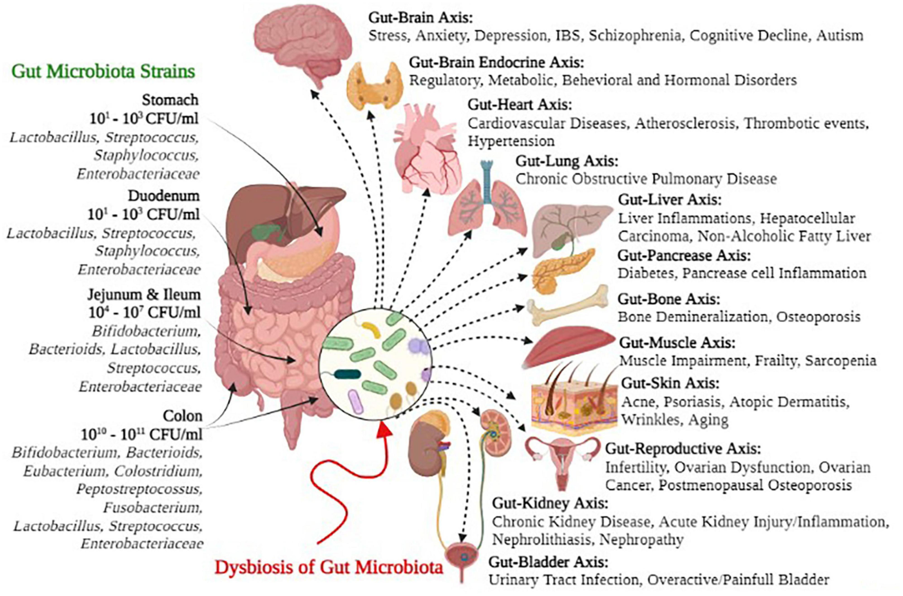
Health Issues Linked With the Microbiome
Health and the Microbiome
Higher microbiome diversity can be good
Health issues that have been linked with microbiome:
Immune system
IBD
Allergies
Eczema
Rheumatoid arthritis
Other diseases
Obesity
Cystic fibrosis
Fatty liver
Mental health
Notes:
Sheila’s slide

Slide 9
Infancy and the Microbiome
Pregnancy
Delivery
Infancy
Toddler
Window of opportunity for microbiota modulation
Maternal Microbiota
Infant Microbiota
Vaginal
C-Section
Breastfeeding
Formula
Diet
Mode of Delivery
Feeding Mode
Antibiotic
Gestational Age at Birth
Maternal Diet
Host Genetics
Host Genetics
Vertical Transmission
Infection
Family Lifestyle
Maternal Stress
Pregnancy
Delivery
Infant
Geographical Location

Slide 10
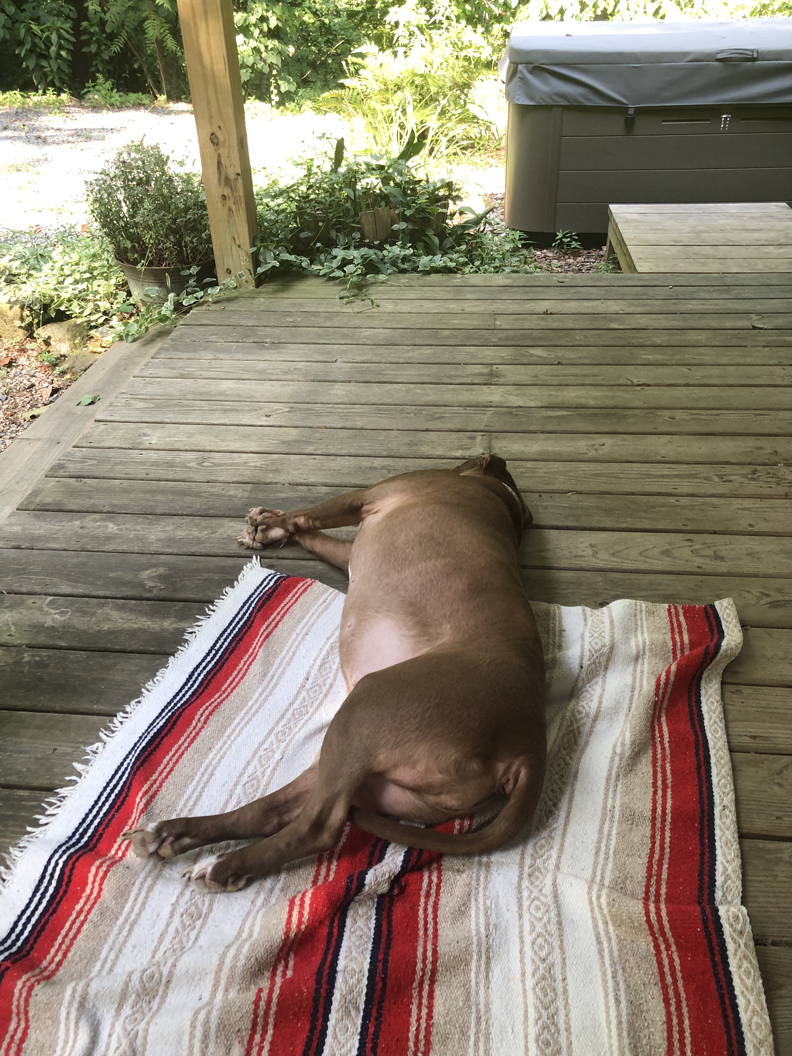
Pets and the Microbiome
Pets have increased microbial diversity
There is a possible link between human and pet microbiome
Notes:
Sheila’s slide

Slide 11
How to Build a Healthy Plate

Slide 12
Influence Of Diet And Lifestyle On Gut Microbiota
Smits et al., Science 2017
Notes:
Amber’s slide

Slide 13
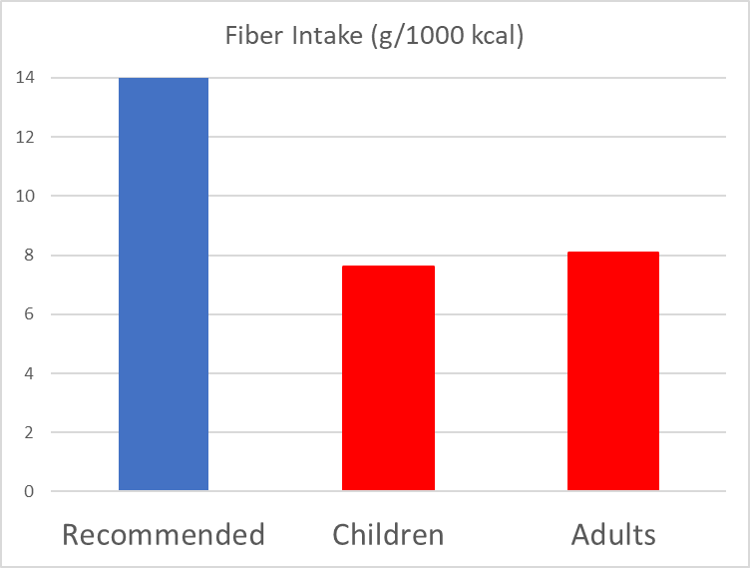
What Are We Feeding Our Microbiota?
What We Eat In America Survey (2017-2020)
Notes:
Amber’s slides

Slide 14
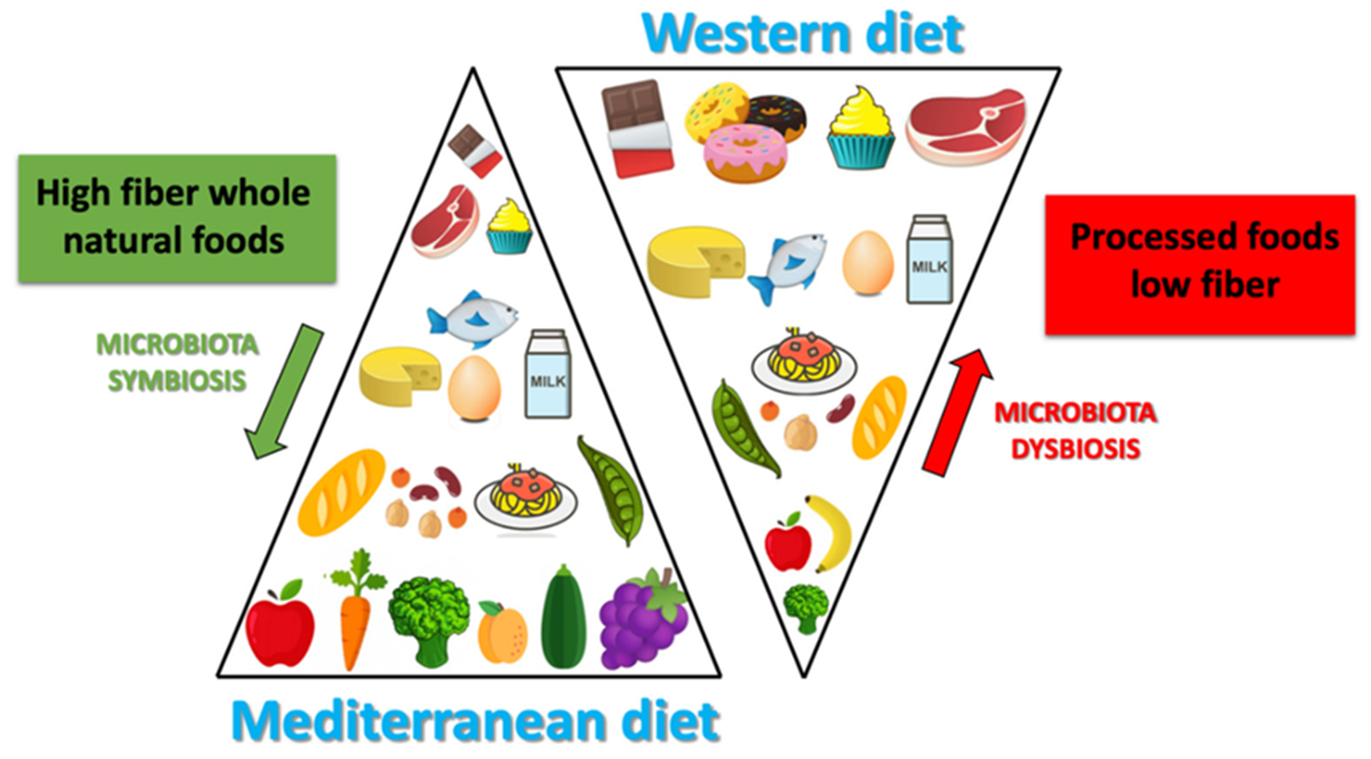
Dietary Patterns
Merra et al., Nutrients 2021. https://doi.org/10.3390/nu13010007
Notes:
Amber’s slide

Slide 15
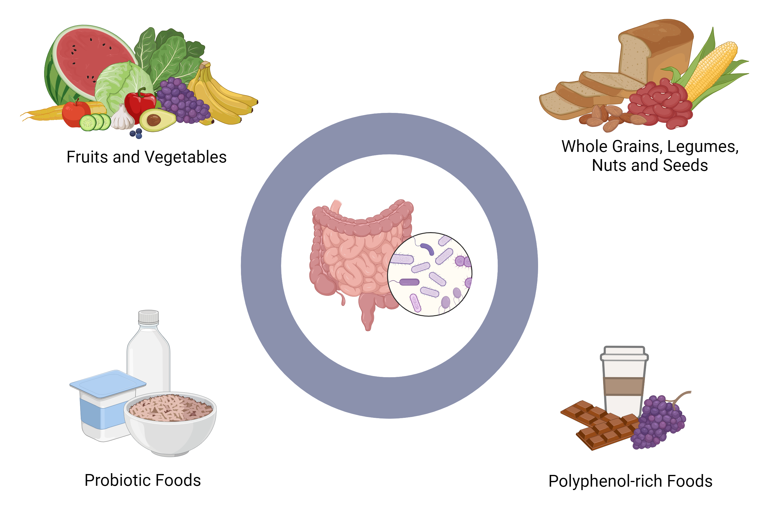
What Do Your Microbes Like to Eat?
Notes:
Leslie will touch on meals/recipe ideas that are good for your microbiome in the next section.

Slide 16
Meal Prep Tips and Tricks

Slide 17
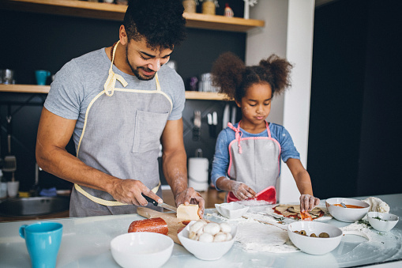
Meal Prep Tips
How to Meal Prep
Plan Out What You Need For The Week
Shopping list, recipes, bulk cooking
Use websites or mobile apps which are designed to help with weekly planning
Try using apps: Myplate.gov, Mealtime Meal Plans and Recipes, Plan to Eat, Plate Joy
Engage Children In Meal Prep
Encourage them to explore recipes they want to help make
Bring kids grocery shopping
Talk your kids through the taste of each ingredient
Minimize Highly Processed Foods
Shop the perimeter of the grocery store
Shop only from the ingredient list
Minimize snacks and focus on whole meals
Include Fiber in Your Meals
Focus on fruits, vegetables, and whole grains
Incorporate nuts and seeds into your meals
Choose a high fiber breakfast
Notes:
Amber’s slide

Slide 18
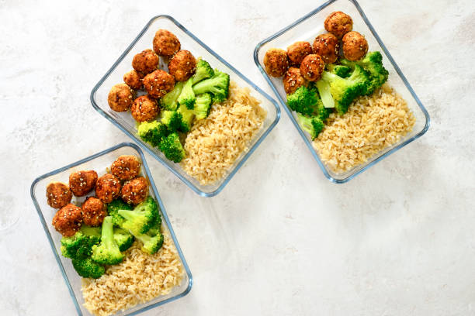
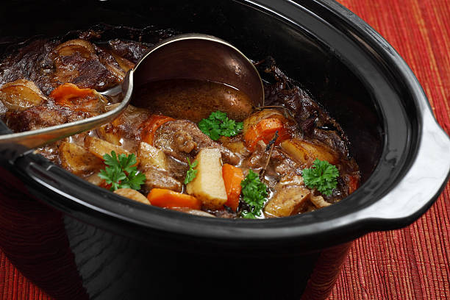
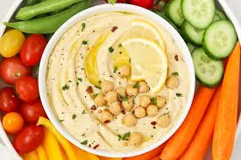
Top Meal Prep Strategies
Four More Strategies for Meal Prep
#1
Prep protein/veggies/carbs to use in a variety of ways
Cook large batch of chicken/protein
Large batches of quinoa or brown rice
Roast veggies to combine w/other side dishes
Cut up veggies for salads/dip
#2
#3
Assemble & avoid stove top
Slow cooker/pressure cooker meals (can also be frozen)
Marinated chicken/meats
Air fryer for meals or sides
Convection oven for meals
Pre-portion things out
Homemade trail mix
Hummus w/mini-snack bags of veggies
Create portion sizes of fresh fruits & a side of yogurt
Snack-size veggie chips
#4
Pre-cooked meals – grab from fridge and reheat as needed
Breakfast – steel cut oats, egg muffins, overnight oats
Lunch – mason jar salads, turkey taco bowls, soup/chili
Dinner – sheet pan meals, stir fry meals, and more
Source: Eurest Dining Services, NIH
Notes:
You don’t need to prep full meals!

Slide 19
Gut Healthy Meal Prep Recipe(s)
Side Dishes
Meal Ideas
Dessert Options
Crispy Paprika Butter Beans
Combine the rich, smokey notes of paprika (optional) with creamy protein-packed butter beans to create a delicious and nutritious snack.
White Bean Soup with Pasta
Combine onion, celery and carrots to flavor this white bean soup. Keep a store-bought bag of the mix in your freezer to ensure you have some on hand without worrying about it going bad.
Tahini & Chocolate Chip Cookies
Tahini is a great source of copper, iron and calcium which can be missed in many standard diets.
Rainbow Rolls with Satay Dip
These rainbow rolls are nutritious, packed with fiber, versatile and easy to make. Use whatever veggies and herbs you have, and the dip is key.
Homemade Sour Fruit Gummies
Healthy, made with fresh fruit and fruit juice, unsweetened gelatin and sweetened with honey. Full of vitamin C, great for immunity and the gut healing, fun to make and a delicious fruity treat.
Chipotle Chicken Quinoa Burrito Bowl
Grilled chicken coated in an (optional) spicy chipotle glaze. Load it with vegetables and quinoa in place of rice to add nutrition for a healthier dinner.
Fermented Foods for Better Gut Health
Harvard Health article on fermenting foods for a healthy dose of probiotics.
Notes:
Focus on fiber, legumes, beans, brown rice, lean meats.

Slide 20
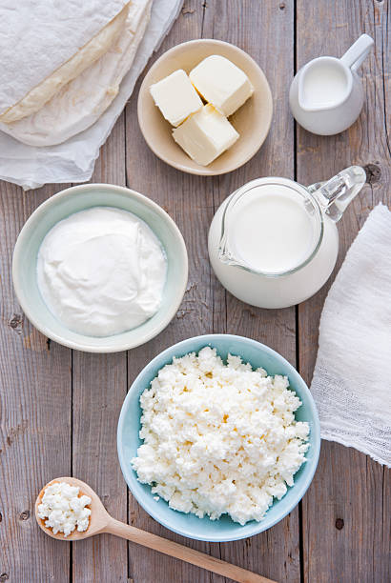
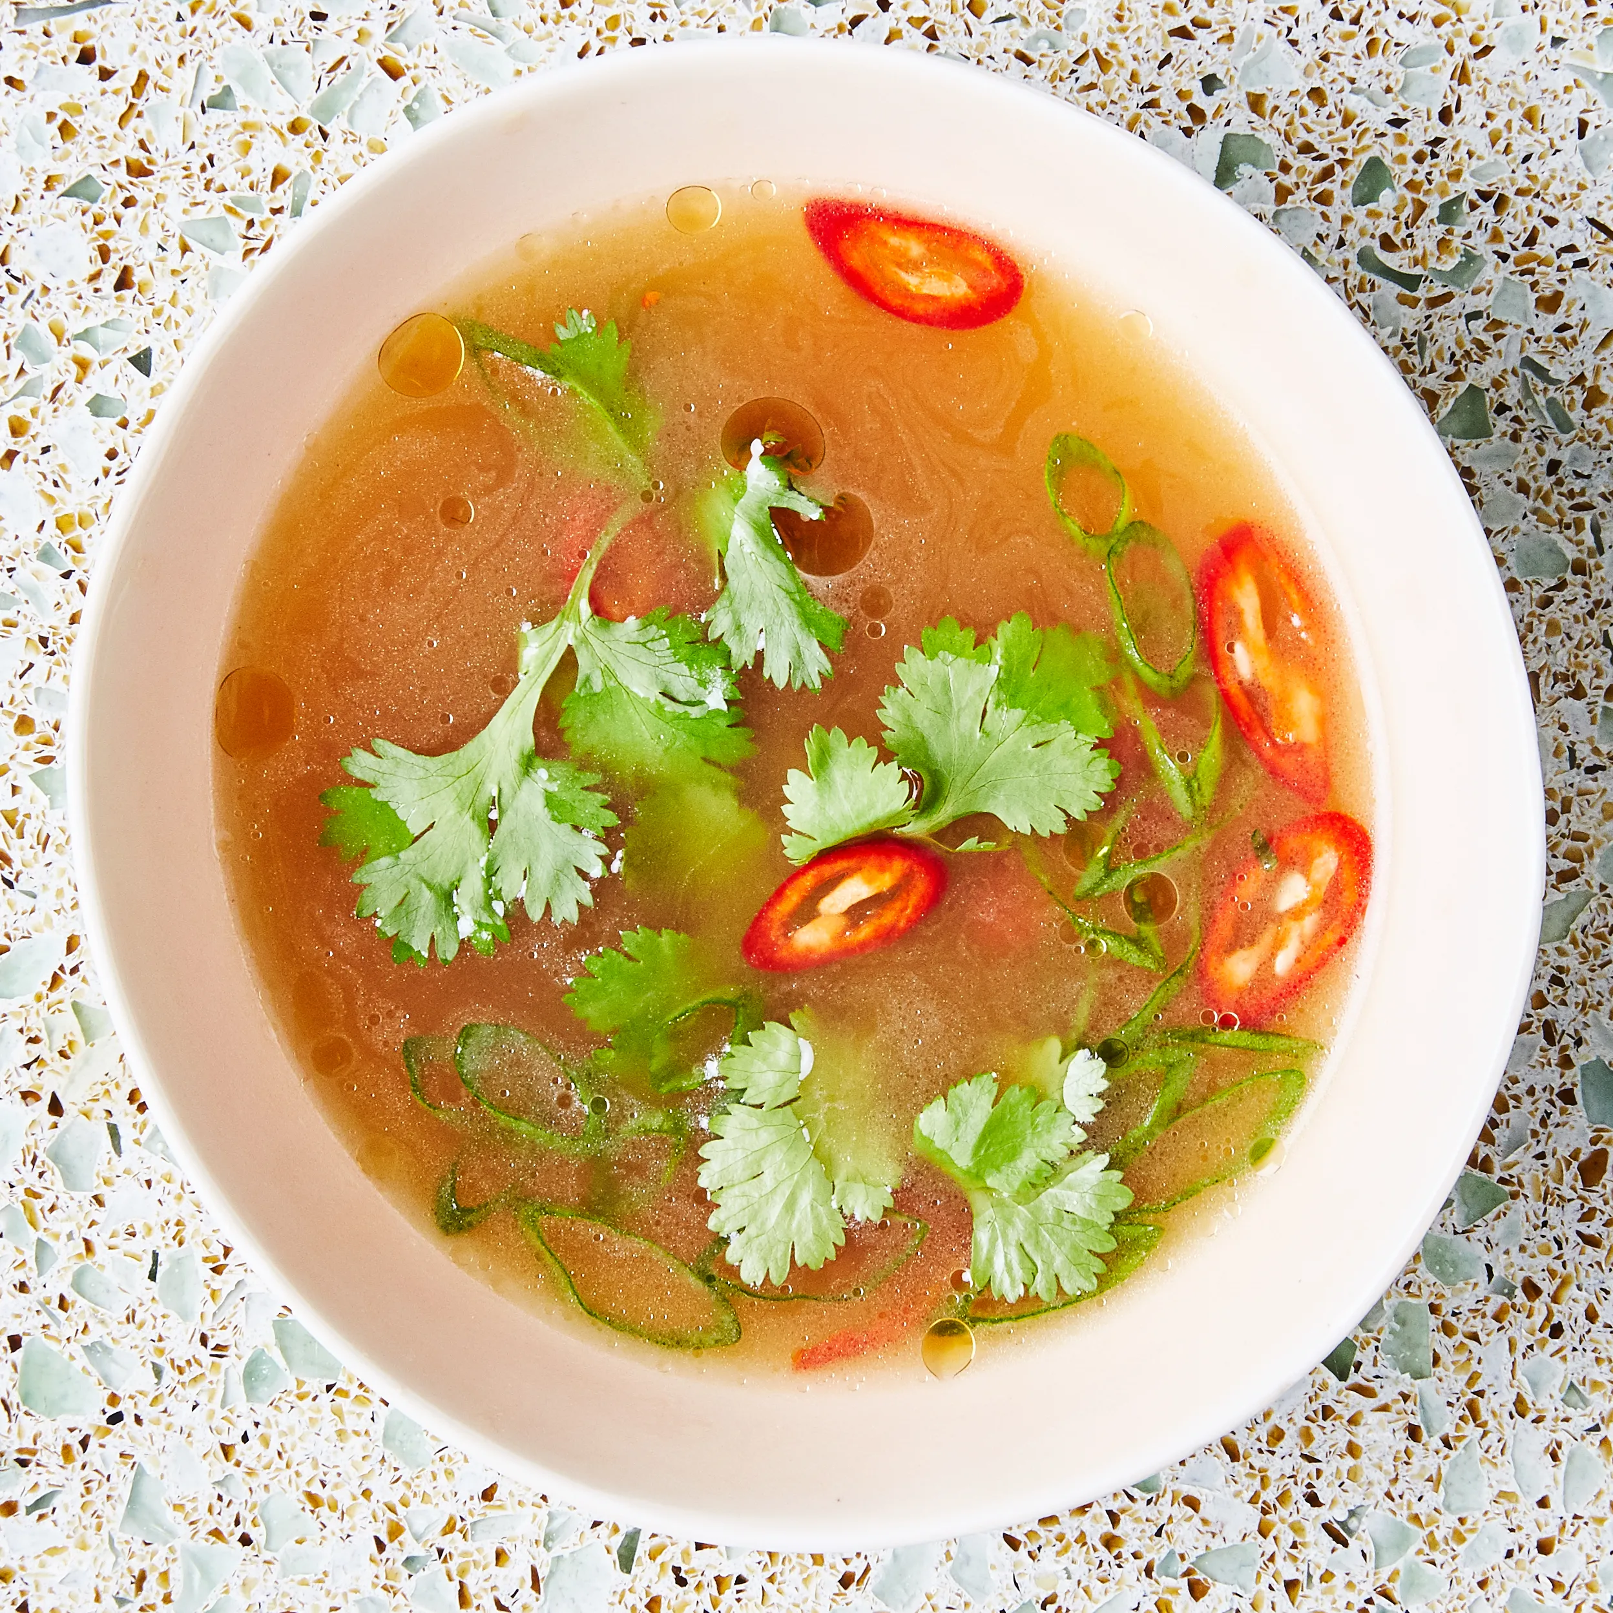
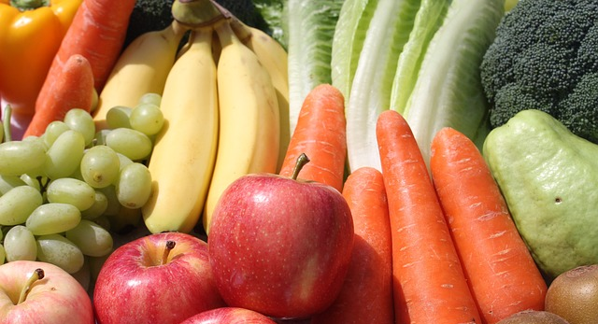
Healthy Meal Prep - Hydrating Foods
Try these top hydrating, microbiome-boosting foods.
Percent hydration, from highest to lowest:
Vegetables:
Lettuce (96%)
Celery (95%)
Cucumber (95%
Zucchini (94%)
Tomatoes (94%)
Bell Peppers (92%)
Cauliflower (92%)
Cabbage (92%)
Spinach (91%)
Kale (90%)
Broccoli (89%)
Carrots (88%)
Fruits:
Watermelon (92%) Strawberries (91%) Cantaloupe (90%) Honeydew (90%)
Peaches (89%)
Oranges (88%)
Grapefruit (88%)
Pineapple (86%)
Apples (85%)
Liquids:
Coconut Water (95%), Broths & Soups (~92%)
Skim Milk (91%)
Soy/Nut Milks (90%)
Probiotic-based:
Plain Yogurt (88%)
Cottage Cheese (80%)
https://www.healthline.com/nutrition/19-hydrating-foods

Slide 21
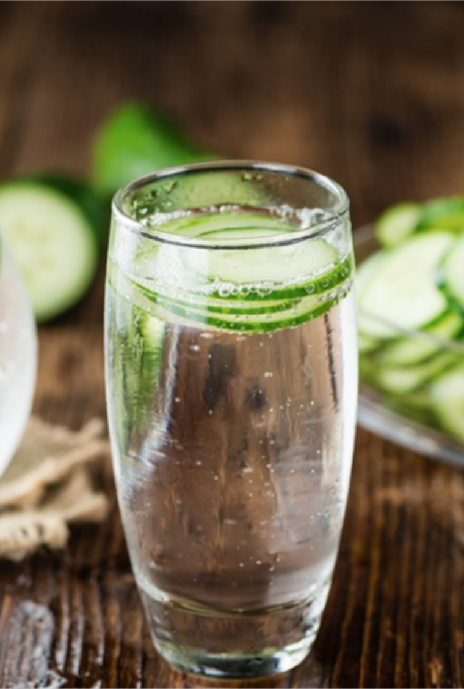
Healthy Meal Prep - Fluids
Eight Tips to Drink More Fluids
1. Drink a glass of water at the following times:
Upon waking
With meals/after dinner
With snacks
Before, during, after exercise
2. Add fruit, herbs or cucumber slices to water to add flavor
3. Drink sparkling water
4. Herbal teas, unsweetened iced tea
5. Buy a large reusable cup and set a goal of how much/daily
6. Limit sugary beverages when trying to hydrate
7. Choose water (add lemon, lime) or sparkling water dining out
8. Track it on an app
Notes:
https://www.hsph.harvard.edu/news/hsph-in-the-news/the-importance-of-hydration/
Harvard states the importance of hydration:
Fluid balance
Combat fatigue
Clearer skin
Normalizes the blood
Controls calories
Brain booster
Greases the joints
Removes toxins
Boosts productivity
Is muscle fuel for movement of all kinds, even walking, standing, etc.

Slide 22
More Meal Prep Recipe Ideas
More Gut-friendly Meal Prep Recipes
5 Make-Ahead Fruit & Greek Yogurt Parfaits
https://projectmealplan.com/make-ahead-fruit-greek-yogurt-parfait-ideas-to-try-for-breakfast/
Slow Cooker Apple Cinnamon Oatmeal
https://fitfoodiefinds.com/slow-cooker-apple-cinnamon-steel-cut-oats/
Mason Jar Salads
https://www.ambitiouskitchen.com/four-mason-jar-salads-with-just-bare-chicken/
Spicy Chicken with Rice and Beans
https://pinchofyum.com/spicy-chicken-meal-prep
Ground Turkey Stir-fry
https://www.budgetbytes.com/ground-turkey-stir-fry/
Source: Eurest Dining, NIH

Slide 23
References
https://www.gastrojournal.org/article/S0016-5085(24)05000-5/fulltext
https://pubmed.ncbi.nlm.nih.gov/37074174/
https://pubmed.ncbi.nlm.nih.gov/30859338/
https://patient.gastro.org/probiotics/

Slide 24
Let’s Keep Sharing!
What are your favorite recipes (website or app) for meal planning ideas?
Enter in the Google Doc: shown in the chat
Notes:
Share recipes by the end of the workshop: https://docs.google.com/spreadsheets/d/1EnKLGz5WNlyLYE3KynN-fifV91a2B1kMAV7VaIrBEiw/edit?usp=sharing

Slide 25
Connect with Wellness
Connect With Wellness at NIH
Prioritize Your Wellness
and Join the
Wellness@NIH Community!
Our Website
Monthly Newsletter
R&W Website
Our Listserv
Facebook Group

