Slide 1
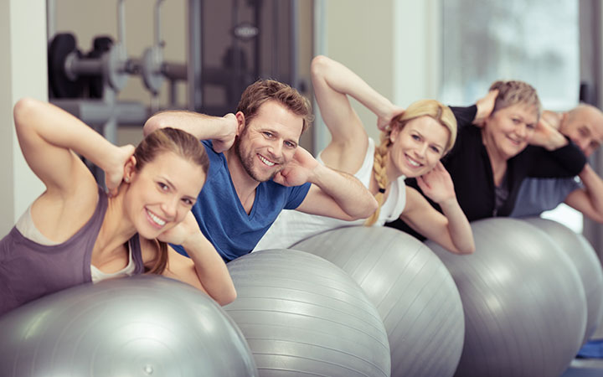
Exercise & How to Use it to Enhance
Emotional Well Being
Shannon Oussoren, MBA
NASM CPT, AFAA, RYT 200

Slide 2
Exercise & Emotional Well Being
Emotional Well Being in the U.S.
Common Causes of Emotional Stress
Impact of Stress on the Body & Mind
Physiological Impact of Stress on Health
Things We Can Do to Combat Stress
Benefits of Exercise for the Brain
Exercise & Effects on Emotional Well Being
NIH & Physical Activity Resources
Questions & Answers

Slide 3
Emotional Well Being in the U.S.
COVID-19, lockdowns and stress have impacted our emotional well being
Americans are among the most stressed in the world
In 2019, the majority of Americans (55%), said they felt a lot stress during the day
With COVID-19, isolation helps reduce infections, but reduced access to social support systems causes loneliness and increases mental health issues like anxiety and depression (^{Zhou et al., 2020}).
Our emotional well being needs to be addressed during this lockdown
Source: Gallup Research (2019) Americans' Are Some of the Most Stressed Out People in the World (2019)
https://time.com/5577626/americans-stressed-out-gallup-poll/

Slide 4

Common Causes of Emotional Stress
Home/Online Schooling
Working Remotely/Meeting Work Expectations
Financial Troubles
Holidays/Gift Giving
Politics and Political Conversations
Health Concerns
Social Isolation
Source: American Psychological Association (2019)
https://www.apa.org/helpcenter/holiday-stress

Slide 5
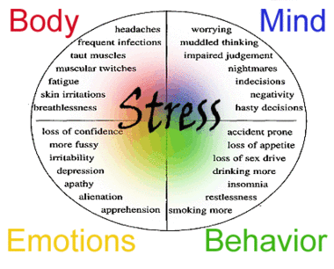
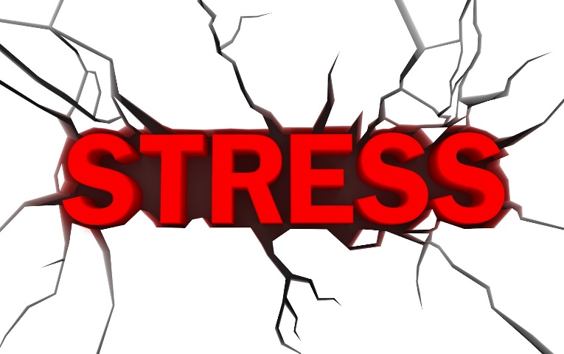
Impact of Stress on the Body & Mind
62% routinely find that they end the day with work-related neck pain
44% reported stressed-out eyes
34% reported difficulty in sleeping because they were too stressed-out
American Institute of Stress (2017) Workplace Stress https://www.stress.org/workplace-stress

Slide 6
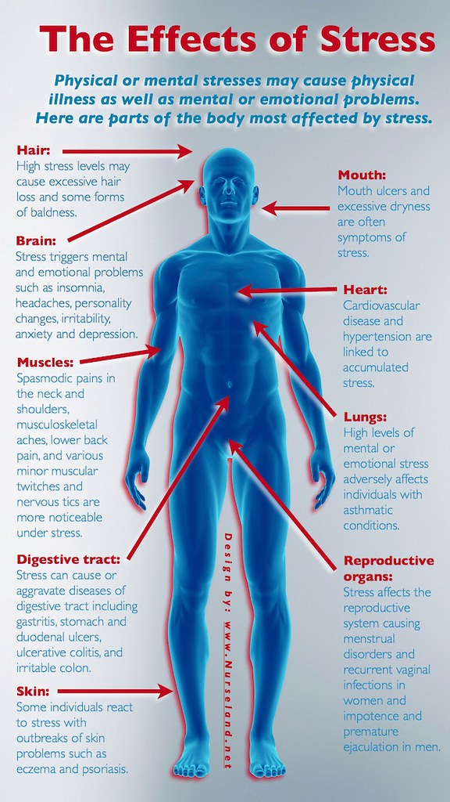
Physiological Impact of Stress on Health
Constant exposure to stress can have devastating impacts on your body, mind, and emotional health

Slide 7

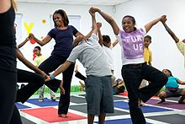
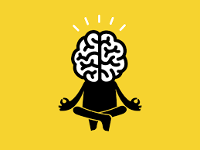
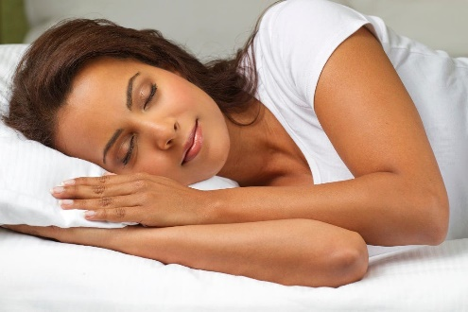

Things We Can Do to Combat Stress
Exercise
What are some of the things we can do to counteract the negative impacts of stress?
Mindfulness Based Interventions: MBSR, Meditation, Yoga, Tai Chi
Sleep – 7 – 8 Hours per night
Eating Right

Slide 8
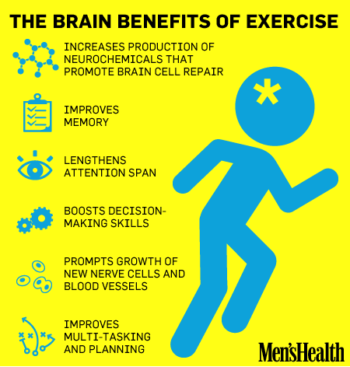
Benefits of Exercise for the Brain
Exercise changes the brain & the body

Slide 9
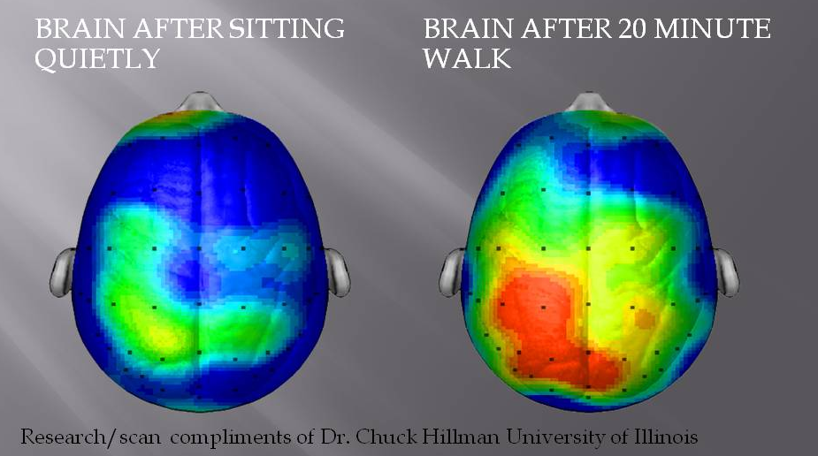
Chemical Changes in the Brain
During Exercise, Neurotransmitters & Hormones Released:
  Serotonin – “calming chemical” mood booster
  Dopamine – “pleasure chemical” – reward in response to behavior
  Endorphins – “runners high” (painkillers)
Ace – Your Brain on Exercise – the Neuroscience Behind a Good Workout
https://www.acefitness.org/education-and-resources/lifestyle/blog/7116/your-brain-on-exercise-the-neuroscience-behind-a-good-workout/

Slide 10
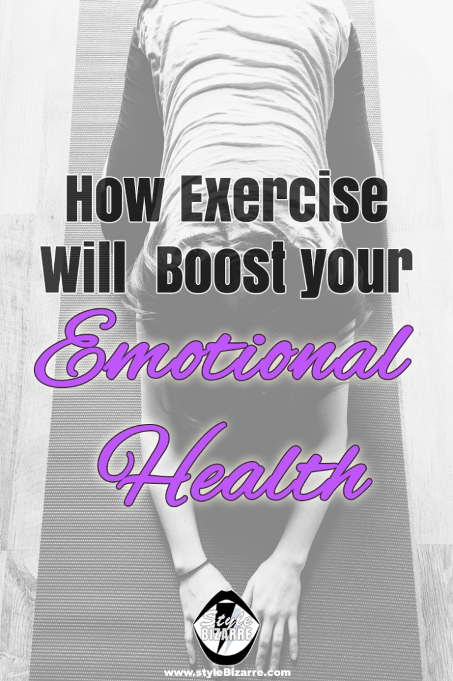
Exercise & Effects on Emotional Well-Being
Reduces feelings of depression & stress
Enhances your mood & emotional well being
Increases your energy level
Improves sleep
Improves self esteem & cognitive function
National Center for Biotechnology Information
https://www.ncbi.nlm.nih.gov/pmc/articles/PMC1470658/
National Institute on Aging https://www.nia.nih.gov/health/infographics/emotional-benefits-exercise

Slide 11
NIH Employee Assistance Program
https://www.ors.od.nih.gov/sr/dohs/HealthAndWellness/EAP/Pages/index.aspx

Slide 12



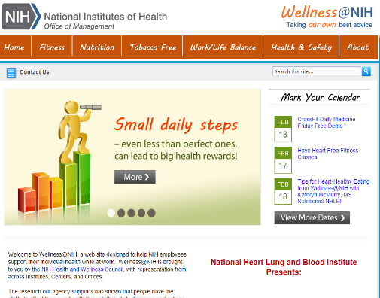
NIH Physical Activity & Wellness Resources
1
2
NIH R&W Facebook Live Classes! NIH R&W Fitness and Wellness Program
3
Bldg. 31
Bldg. 53
4
Rockledge 1
Bayview
5
Wellness@NIH Website

Slide 13
Questions & Answers
Question | Answer | Reference
What is the best type of exercise to improve a depressed mood? | Several studies have concluded that the exercises that were most effective in relieving depression were: * Vigorous * Uninterrupted for a period * Required less focus and decision-making than real life | https://www.betterhelp.com/advice/depression/what-research-says-about-exercise-and-depression/
I have trouble getting out of bed and getting going in the morning especially when it’s cold outside. Are there any exercises that will help get me going in the morning? | Exercising in the morning is not appropriate for everyone. For example, if you have depression, rheumatoid arthritis, sleep issues, etc. it may be more effective for you to exercise later in the afternoon or evening. If exercising in the morning is your only option, consider: * Starting with gentle stretching in bed * Using breathing techniques (breath of fire) * Drinking a cup of tea or coffee (just one) or a glass of juice before you exercise | https://www.quickanddirtytips.com/health-fitness/exercise/should-you-exercise-in-the-morning-afternoon-or-evening
Please, will the video recording be available after the seminar? | Yes
Is there a threshold for optimal health benefit from physical activity? | * At least 150 minutes per week of moderate-intensity aerobic activity or 75 minutes per week of vigorous aerobic activity * Add moderate- to high-intensity muscle-strengthening activity at least 2 days per week. * Even light-intensity activity can offset some risks of being sedentary. * More benefits by being active at least 300 minutes (5 hours) per week. * Increase amount and intensity gradually over time. | https://www.heart.org/en/healthy-living/fitness/fitness-basics/aha-recs-for-physical-activity-in-adults
I'm always disappointed in myself when I don't get out of bed for my workout but I have such a difficult time motivating myself to get up. Any suggestions? | First look at the time you are working out. We all have different bio rhythmic clocks. Select the time you feel most energetic and have the fewest distractions. 4 ways to motivate yourself: 1) Reward yourself. Make the benefits of working out more tangible by rewarding yourself. 2) Sign a Contract. Make a pledge in front of family and friends. 3) Think Positively. Visualize the benefits and imagine your obstacles, develop a plan to overcome them. 4) Find your Fitness Friends. Neighbors, friends, work associates. | https://www.google.com/amp/s/dailyburn.com/life/fitness/workout-motivation-tips/amp/

Slide 14
Questions & Answers
Question | Answer | Reference
Please discuss the importance of not sitting or standing in front of the computer for hours without moving around. | Sitting is the new smoking in terms of detrimental effects on your health. Sitting hinders blood flow, causes build up of fatty tissue and can cause a whole host of adverse health issues including tight hip flexors and hamstrings, low back pain, forward leaning posture. Locate your desk near your exercise equipment, treadmill, weights. Stand up and walk around during calls. Buy a good tripod or selfie stick that allows you to move around on calls and during meetings.
How to overcome procrastination or inertia | Please see answer to Tricia's question above and: 1) Log your activity 2) Set goals and commit to them 3) Do some stimulating breathing exercises
I'm eager to know the benefits of exercise to give me more motivation. | Please see slides 8 - 10
What is of more benefit, length of time exercising? or distance covered? (say, in brisk walking). thanks | Good question but my answer is neither. I would say quality and intensity are your goals. For instance - working out for an hour but not using proper form, not engaging key muscle groups or your core - reinforces muscle imbalances, creating compensation across the kinetic chain that can be harmful to the body. Likewise - It’s better to walk 2 miles using proper form than 5 using improper form. Ask yourself - is the exercise safe, am I doing it properly, how can I make it more effective?
What exercises do you recommend for weak core muscles? | Almost all body movement originates in the core. It’s all about the core! 1) Forearm Plank 2) Bird Dog 3) Bridge 4) Clamshells 5) Prone Swimmer 6) Dead bug

Slide 15
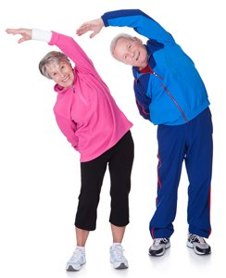
Thank You – Let’s Get Moving!
Shannon Oussoren, MBA, NASM CPT, AFAA, RYT 200

