Slide 1
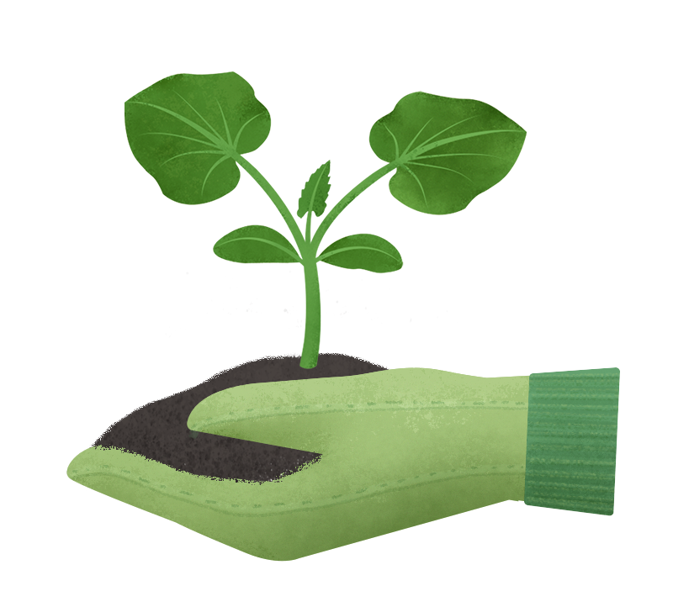
Registration Guide – Spring 2024

Slide 2
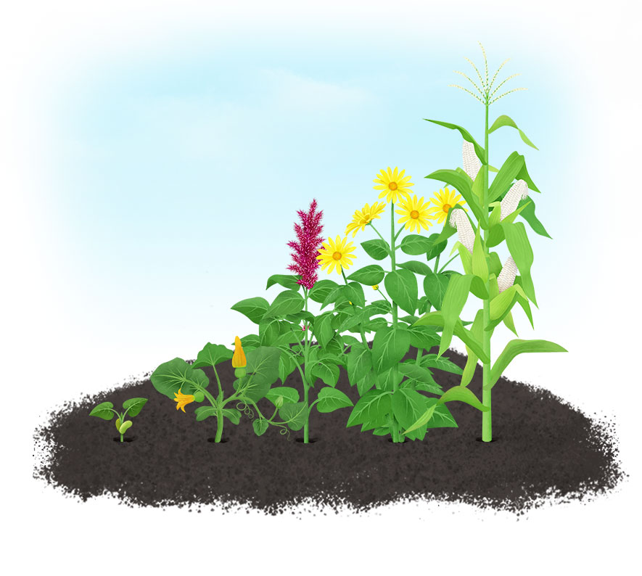
Challenge Overview
Each healthy habit you record contributes to growing a virtual plant bearing vegetables, fruit, or grains from around the world.
Nourish is open to all Federal agents and household family members (18 yrs old and over).
The goal is to grow 30 plants during the 6-week program. Aim for at least 5 plants a week to reveal delicious, healthy recipes featuring the ingredients you’ve grown.
Teams of up to 5 participants can be formed and may be the most fun part of this challenge. If you decide to join a team, you will be able to earn additional points upon completion of challenges on Thrive Thursdays.
In addition, you will be able to test hundreds of delicious recipes.
The Nourish mobile app automatically syncs with your online account using the same email and password.

Slide 3
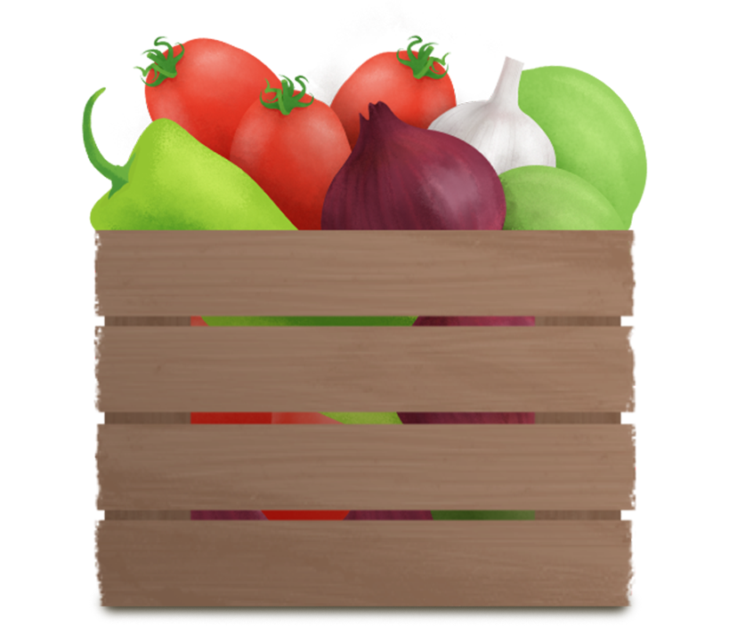
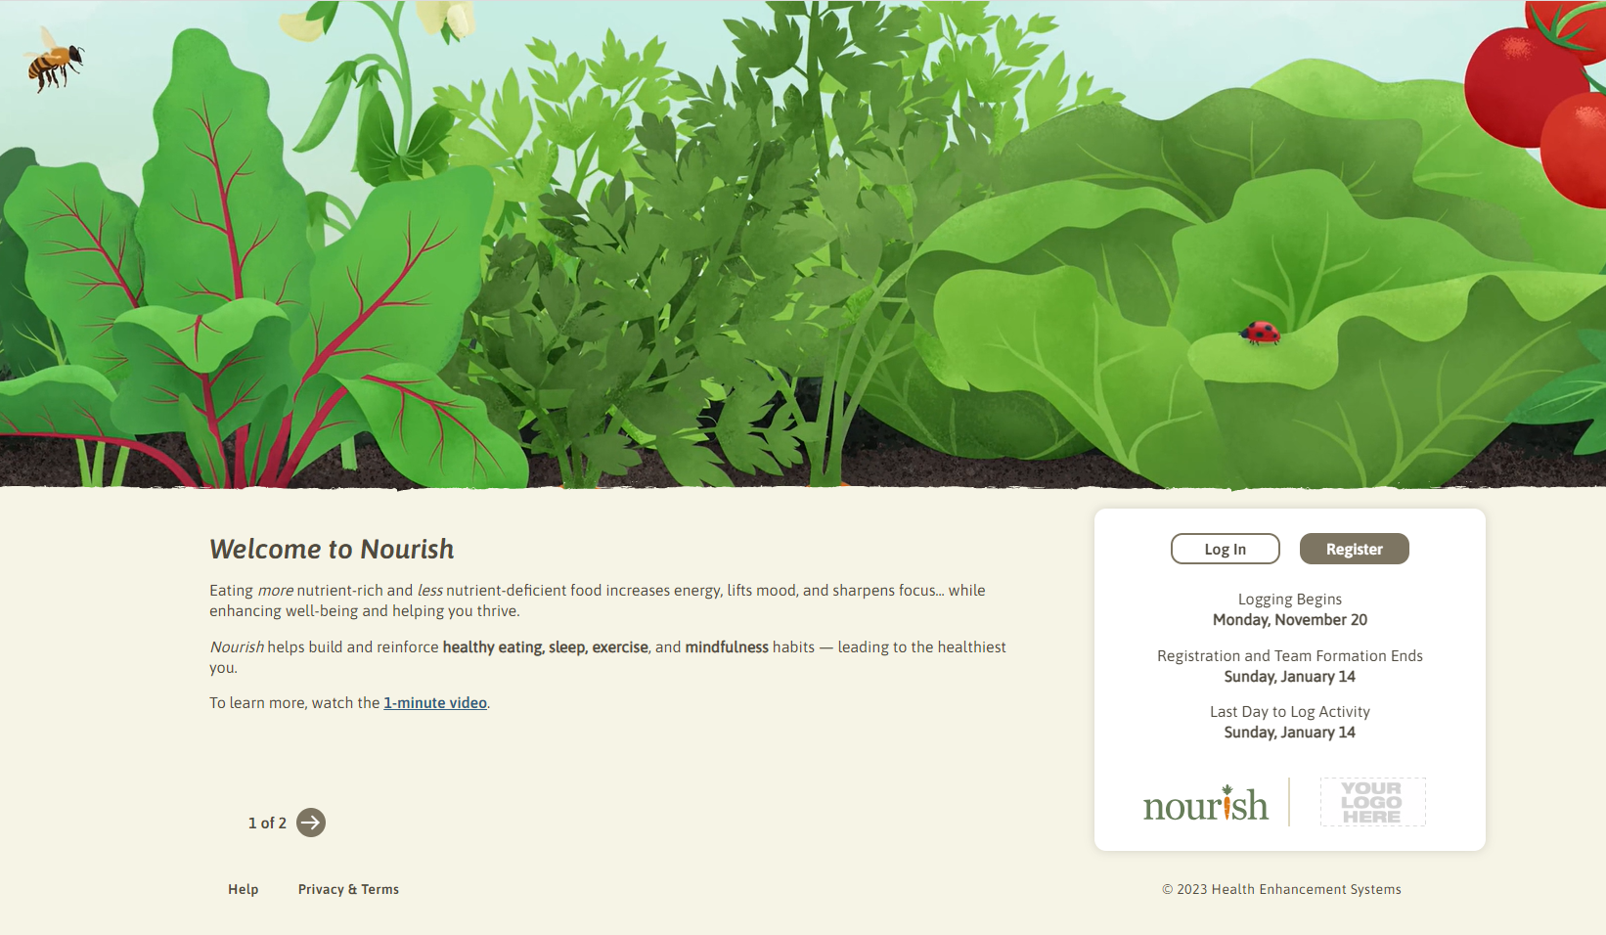
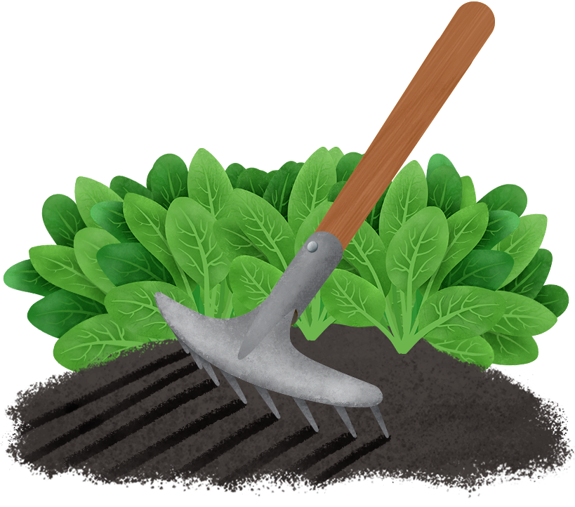
How to Register
Go to https://fedsgetfitmas.thenourishgarden.com

Slide 4
How to Grow Plants
Each healthy habit you record contributes to growing a virtual plant bearing vegetables, fruit, or grains from around the world.
Grow a full plant by recording 2 activities a day; 3 to grow a “prize plant”.

Slide 5
Create or Join a Team
Team participation makes Nourish even more fun and effective.
Our data shows that participants in teams of 4 or 5 have double the chance of achieving their program goals than those flying solo.
Team Formation | Thrive Thursdays | Team Scoring
All teams must be formed by Monday, April 8. The team competition will end on Sunday, May 12. Teams consist of up to 5 members (yourself plus 4 others). The individual who starts the team is the team leader. You can be a member of only one team, and once you join a team, you may not switch to another team. | If you’re on an official team, you’ll find an additional activity in your email on Thursday mornings and on the Team page. If you complete it by midnight CT, you’ll earn bonus points for your team; Thrive Thursdays do not impact individual scores. | Scores are based on the team’s average points, including Thrive Thursday challenges. Each person’s individual contribution affects the team score, so gather a group who will encourage and support each other along the way.

Slide 6
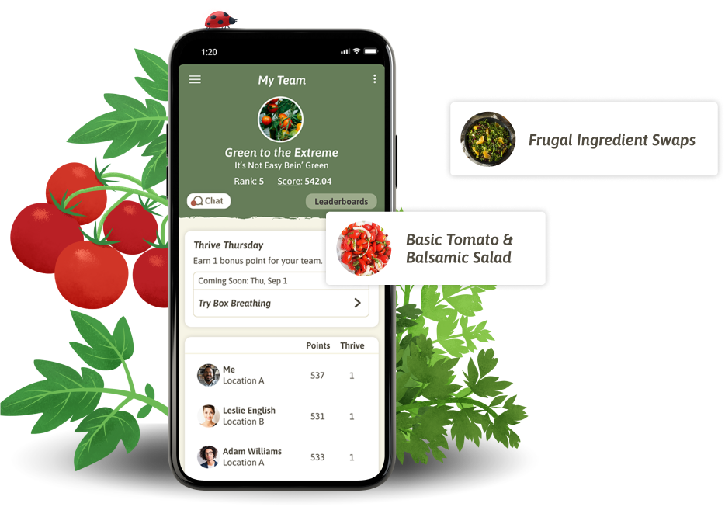
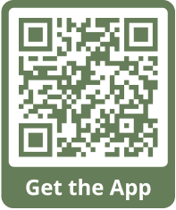
How to Log Activity
Mobile app
Website
Notes:
NOTE: Registration should be open before presenting this slide to users. Users must register before they can log in to the mobile app.

Slide 7
Important Campaign Dates
Monday, March 18
Registration start date
Monday, April 1
Participant start date (record progress)
Monday, April 8
Registration end date (last day to join team)
Sunday, May 12
Tuesday, May 14
Last day to log activity
Last day of the program

